Slide 1
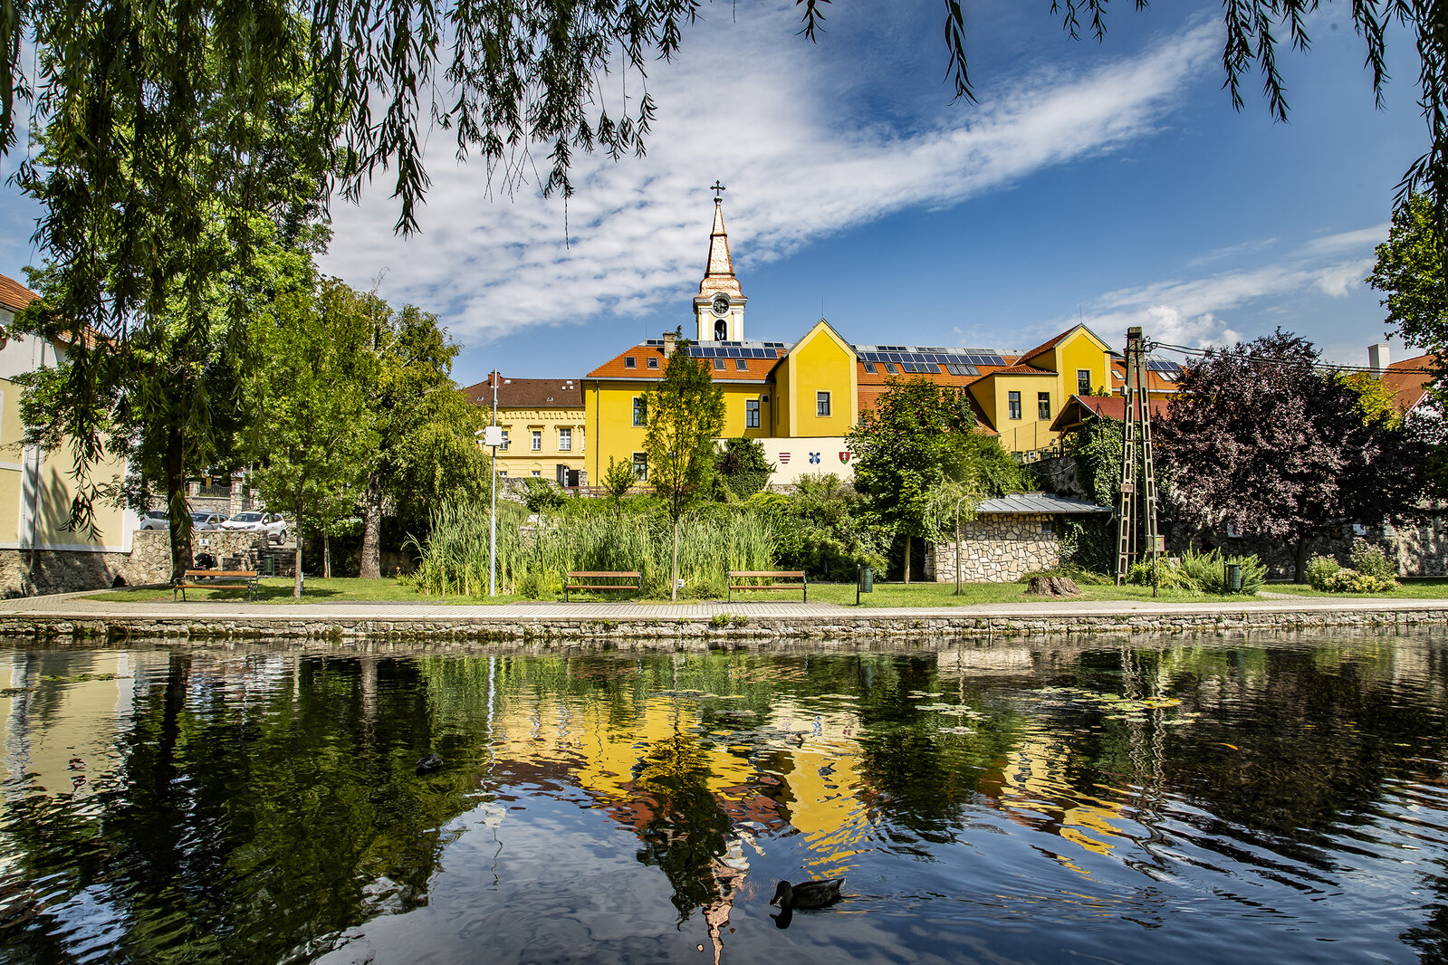
A city in Veszprém county.

Slide 2
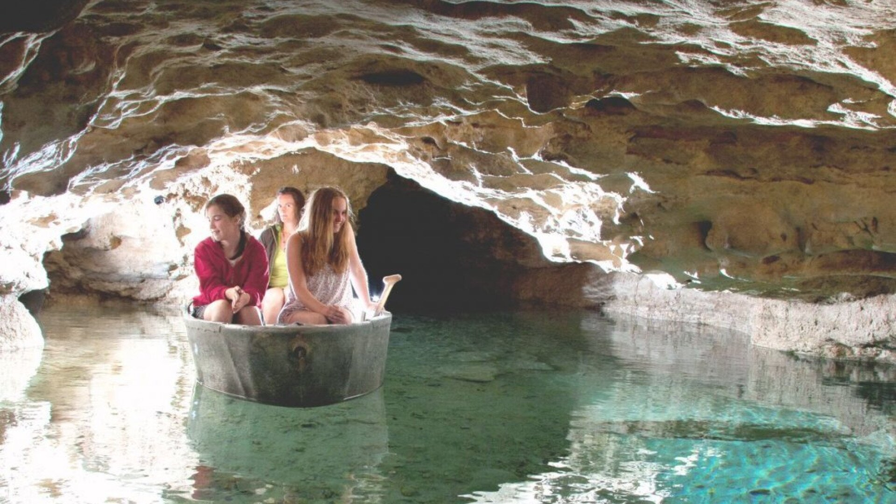
The Tapolca Lake Cave -
The cave system consists of three caves: Tapolca Lake Cave, Hospital Cave and Károly Berger Cave.
The tapolca water cave is a karst cave carved by groundwater dissolving limestone over milennia.
Discovered in 1903 by Tóth Pál and Németh Ferenc while well-digging. Opened to the public 10 years later. Its the first electricity installed cave in Hungary and the first cave opened to tourism. Its strictly protected due to its geological and biological values since 1982.
The discovery of the karst.

Slide 3
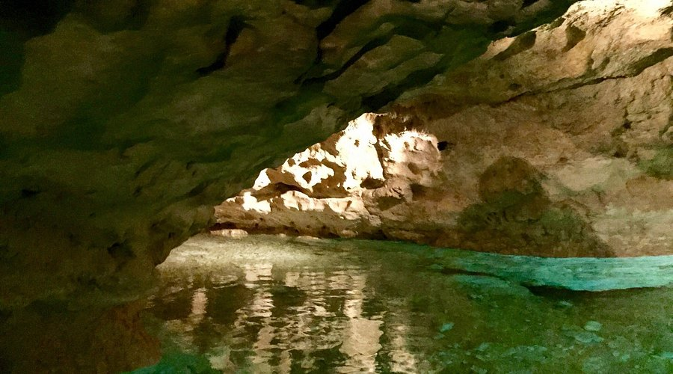
The Tapolca Lake Cave -
How long is it?
The cave is 3 km long but only 300m is opened to visitors. The section of the lake cave that’s navigable by boat is 180 metres in length, with an average depth of 40 cm, although it is several metres deep in places.
It’s 15-20m beneath the town.
In 2015, the lake cave was expanded with a modern Visitor Centre. The Centre provides a lot of interesting programmes regarding caves and karst regions, prehistoric paintings and even a virtual exploration through holographic photographs.

Slide 4
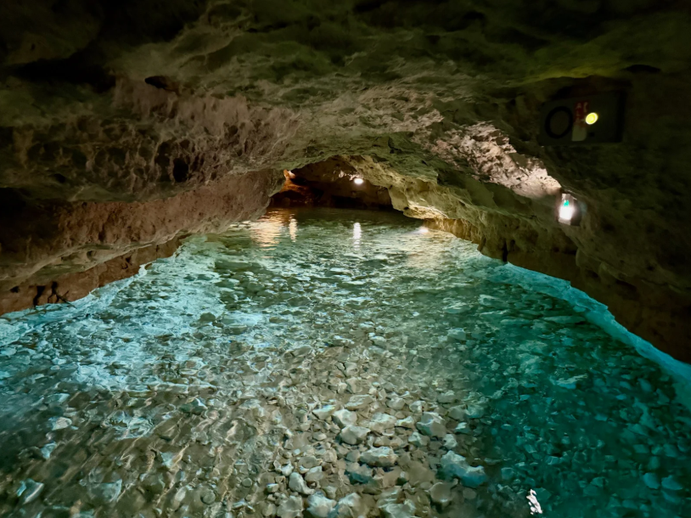
The Tapolca Lake Cave – Health Effects.
The typical factors of speleotherapy (clean air and high carbon dioxide content) make this cave beneficial to those who suffer from asthmatic and respiratory diseases.

Slide 5
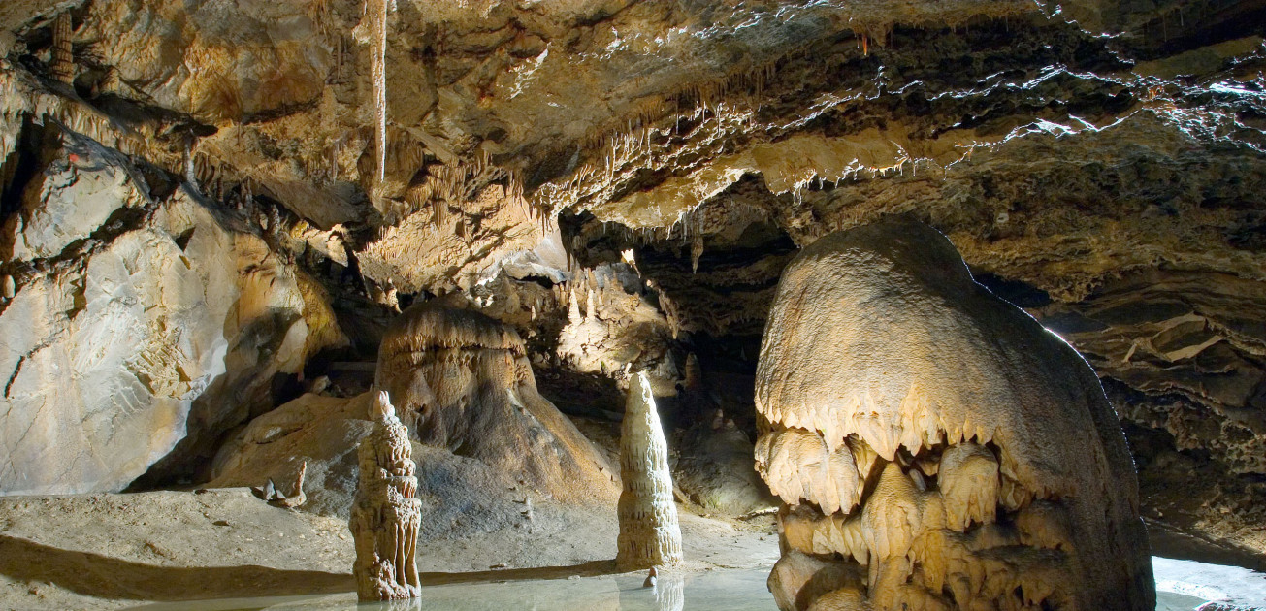
The Tapolca Lake Cave -
Is it clean water?
The water gets it's beautiful blue colour from the minerals that dissolve from the limestone walls, its also slightly alkaline with a pH between 7.2 and 8.3. The light enters the water and reflects from the white limestone walls, making the it appear bright blue. It also looks blue because it’s very clear and clean.
In 2012, the Tapolca Lake Cave was renovated, so visitors are greeted by the illuminated lake cave.

Slide 6
