Slide 1
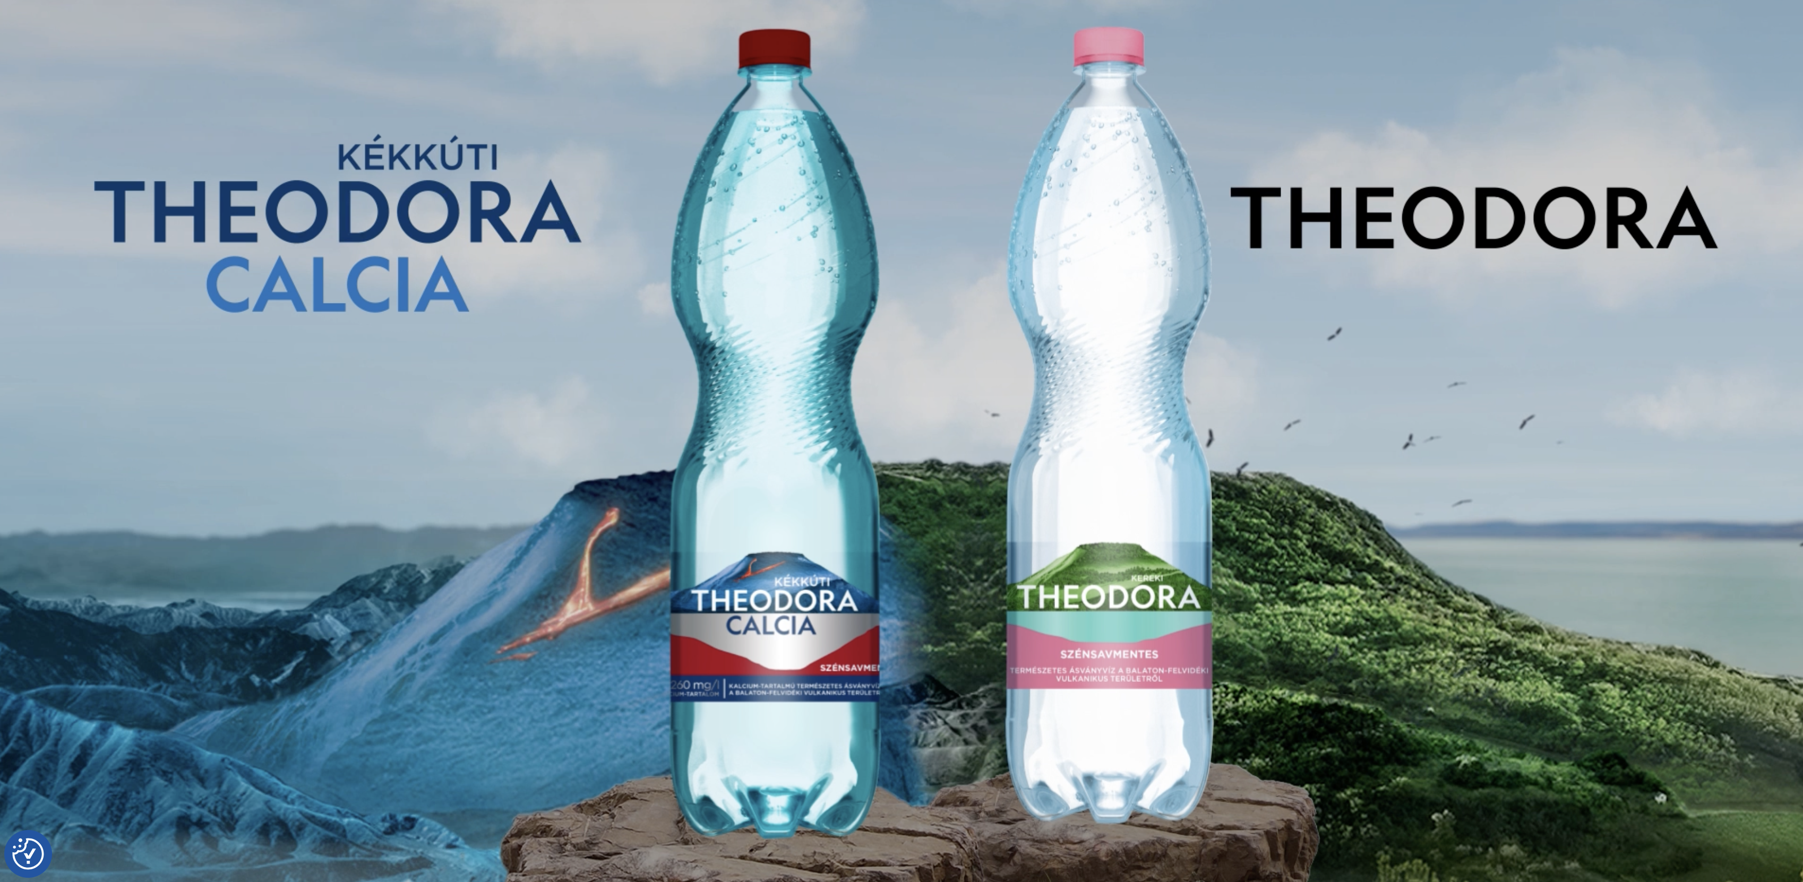
The Kékkút Water Factory (Theodora Mineral Water)

Slide 2
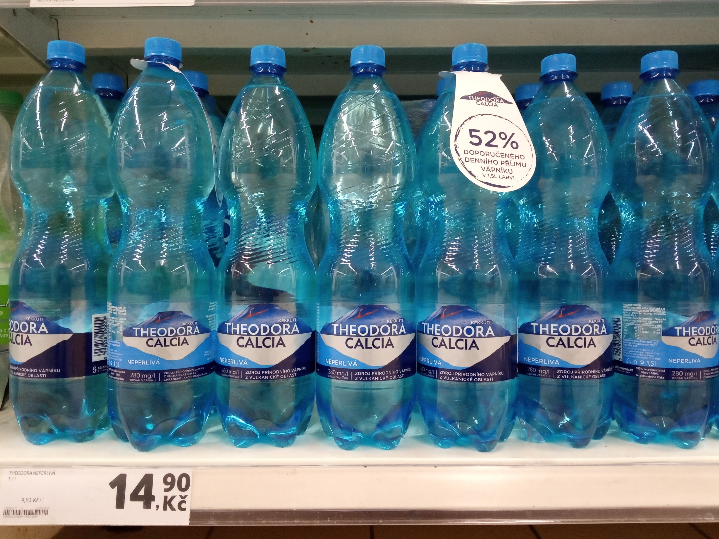
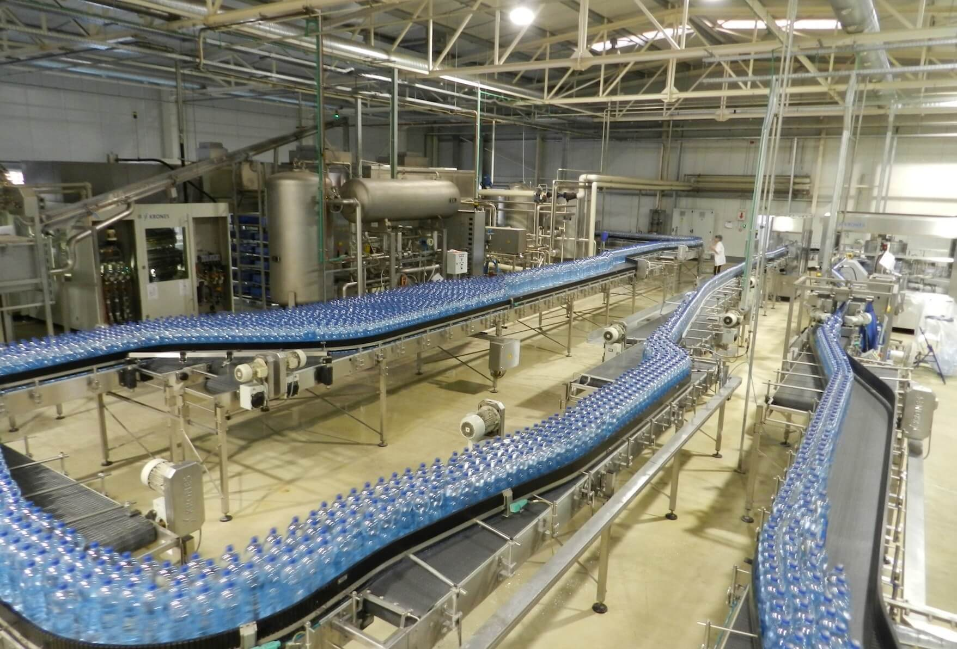
Company Overview
Kékkúti Mineral Water Company is one of Hungary’s oldest and most famous mineral water producers.
The factory is located in the village of Kékkút, near Lake Balaton. Known for its
Theodora brand, the company’s history dates back to the 19th century.
Today, it combines traditional craftsmanship with modern technology.

Slide 3
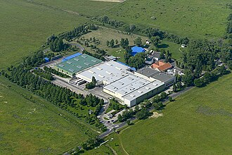
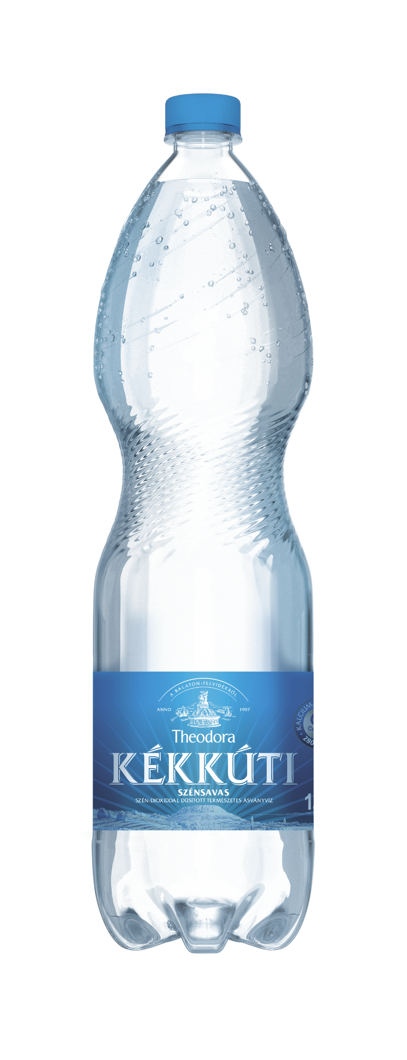
Historical Background
The water from Kékkút was first used locally and known for its medicinal or spring water properties.
Around 1907, the first commercial bottling began (initially under the name “Anna-forrás” / “Anna source”).
In 1921, the brand name “Theodora” was introduced for the bottled water.
Over the decades, the company became a formal “Gyógy- és Ásványvíz” (Medicinal & Mineral Water) enterprise.
After political and economic changes in the mid‑20th century, the enterprise was reorganized, modernized, and later merged with Szentkirályi to strengthen its market presence.

Slide 4
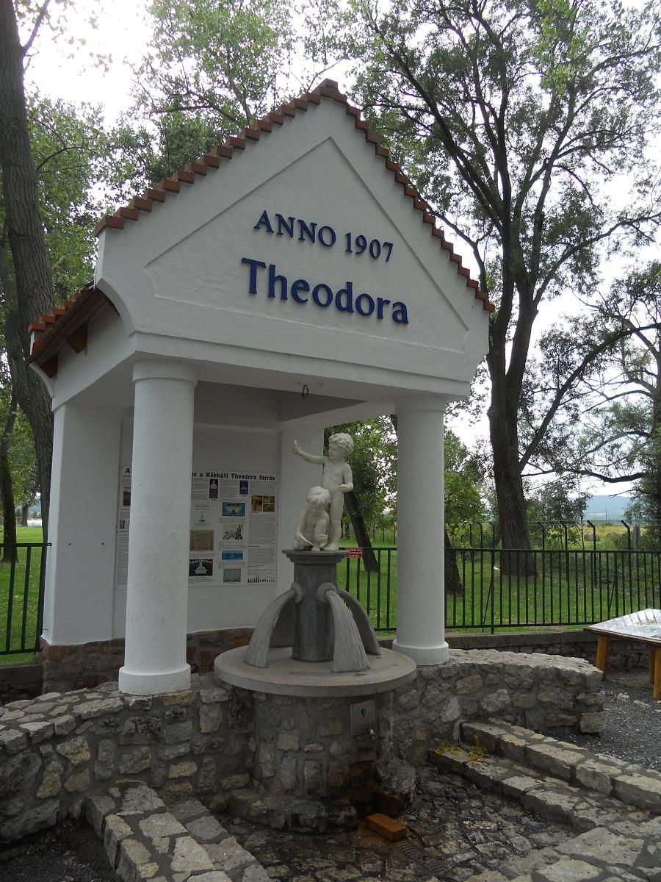
The Source and Water Quality
The water comes from deep natural springs in the Balaton Highlands.
It is naturally carbonated and rich in minerals such as calcium, magnesium, and bicarbonate.
The source is protected by strict environmental regulations.
The bottling process keeps the water’s natural purity intact.

Slide 5
Modern Developments & Capacity
In recent years, the company has made significant investments in infrastructure:
• In 2017, a €2.6 million syrup‑mixing plant was inaugurated in Kékkút to allow production of fruit‑flavored mineral water.
• The merged company (Szentkirályi & Kékkúti) achieved strong financial performance: in the first year after merger, revenue was15 billion FT, with 360 million liters sold.
• In 2018, the production capacity was doubled via a new bottling line (Krones line, in a 1,500 m² hall) — up to 32,000 bottles per hour. These upgrades help the factory remain competitive and adapt to consumer trends (e.g. flavored waters, higher volume)

Slide 6
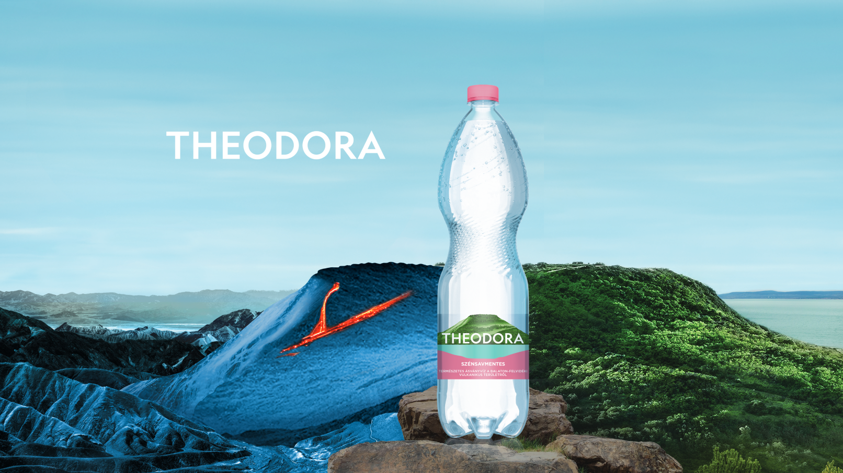
Thank you for your attention!
Presented by: Csongor Gáspár, Balázs Gyulai, Patrik Horváth, Kevin Bóka, Gergely Futó

